Slide 1
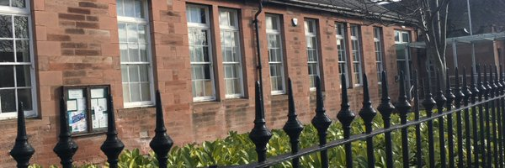
Welcome to Rosewell Primary
22nd September 2021

Slide 2
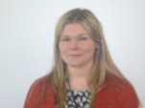
Miss Ormsby and Mrs Bernard P3/2
Notes:
Each teacher to introduce themselves

Slide 3
Practical Points
Encourage your child to be independent eg. Packing/unpacking own bag, handing over letters
Indoor shoes
Regular handwashing throughout the day
Label everything!
Notes:
Lots of jumpers and cardigans left with no name.

Slide 4
Literacy at First Level
Phonics and Spelling linked to Read Write Inc.
Weekly opportunities for extended writing lessons
Opportunities for Book/Author studies
Handwriting lessons – correct letter formation and opportunity to practise cursive writing.
Notes:
L
Explain revision of sounds from P1 – middle blends.
Word walls from RWI
Writing based on personal experience – diaries and functional writing – posters

Slide 5
Literacy at First Level
Group Readers – developing reading skills
Rosewell Tricky Words Lists
Grammar taught through reading and writing and as a stand alone when required
Writing linked to IDL (Our Bodies) and stand alone genre (Reports)
Notes:
L
Explain revision of sounds from P1 – middle blends.
Word walls from RWI
Writing based on personal experience – diaries and functional writing – posters

Slide 6
Numeracy & Maths at First Level
Following MUMP Progressions
Taught through practical application (SEAL) and activities as well as written tasks, games and ICT activities
Talking about how they got an answer/ strategies used
Notes:
K
Explain about MUMP and resources used
Talk about examples of games used to consolidate skills and use these in a practical and real experience
Interdisciplinary links – shopping and money

Slide 7
Numeracy & Maths at First Level
Links to our IDL work –e.g. money and shops
Basic Maths Facts
Sumdog - online
Maths Week Scotland – a focus for the whole school eg numeracy and maths linked to a story.
Notes:
K
Explain about MUMP and resources used
Talk about examples of games used to consolidate skills and use these in a practical and real experience
Interdisciplinary links – shopping and money

Slide 8
IDL (Interdisciplinary Learning) at First Level
May have a main focus of Social Subjects or Science e.g Our Body
Links to Outdoor Learning
Links multiple curricular areas for breadth of coverage and application eg numeracy skills linked to weather
Notes:
D
Using a working wall to find out about what they know already and what type of things they would like to know about.
The children have the opportunity to lead the learning.
The topics are flexible to allow us to explore current affairs or things which the children show an interest in.

Slide 9
Health and Wellbeing
School values: Work Hard, Be kind, Be Confident
School expectations: Ready, Respectful, Safe
2 sessions of PE – Tuesday and Thursday
Bubble Box & HWB Webs
Emotional, Physical and Social- e.g. Friendship, families and diversity
Notes:
Kit

Slide 10
Parental Engagement
Online Learning Journals – your contributions are very valuable and appreciated
Friday Feedback and Twitter
Termly Overviews to share our learning
Notes:
K

Slide 11
Online Learning Journals
Shared regularly
Targets and Next Steps set
Learning as well as Wider Achievement – you are encouraged to share these with us too!
Ongoing assessment – brief end of year report
Notes:
K

Slide 12
Home Learning
Home learning posted on Google Classroom every week.
Google Classroom to be accessed via Google Workspace – contact school via email with any issues.
Notes:
Monday - Monday

Slide 13
Home Learning
Reading
Library Books
Bug Club
We encourage children to aim for at least 20 minutes reading each evening
Spelling
Active spelling tasks – linked to sounds and spelling patterns being taught
Numeracy
Various numeracy tasks using Sumdog or Education City
Notes:
D

Slide 14
Thank
You

